Slide 1

Protecting Secrets
Introduction to Cyber Security
Lecture 4
Dr. Farshid Keivanian
Lecturer, Information Technology, PFBS

Slide 2
Protecting Secrets

Slide 3
Outline
Symmetric Encryption
Asymmetric Encryption
RC4
RSA
Hack a message

Slide 4
References
This lecture is based on
Cryptography and Network Security: Principles and Practices,
7th Ed, William Stallings, 2017
Chapter 4, 8, 9

Slide 5
Symmetric Encryption

Slide 6
Symmetric Encryption
What is Symmetric Encryption?
Symmetric encryption is a method of securing data where the same key is used for both encryption and decryption. This means that both the sender and the receiver must have access to the same secret key.

Slide 7
Symmetric Encryption
Common Names for Symmetric Encryption:
Conventional cipher
Private key cipher
Secret key cipher
Single key cipher

Slide 8
Symmetric Encryption
How Does It Work?
The sender encrypts the message using a secret key.
The receiver decrypts the message using the same key.
If an unauthorized person gets access to the key, they can read the message.

Slide 9
Symmetric Encryption
Examples of Symmetric Encryption Used in Australia
Bank Transactions: Banks use AES (Advanced Encryption Standard) to secure online transactions.
MyGov Services: The Australian government uses encryption for protecting data on platforms like MyGov.
Wi-Fi Networks: WPA2 encryption on home and public Wi-Fi networks in Australia.

Slide 10
Comparison: Symmetric vs. Asymmetric Encryption
Feature | Symmetric Encryption | Asymmetric Encryption
Key Usage | Same key for encryption & decryption | Different keys for encryption & decryption (public and private key)
Speed | Faster | Slower
Security | Less secure if the key is exposed | More secure as private key is not shared

Slide 11
Comparison: Symmetric vs. Asymmetric Encryption
Feature | Symmetric Encryption | Asymmetric Encryption
Example Uses | File encryption, banking, Wi-Fi | Digital signatures, secure email, HTTPS

Slide 12
Symmetric Encryption
Research Discussion Questions
Why was symmetric encryption the primary encryption method before public-key cryptography was developed?
It was simpler, faster, and practical for early communication systems.

Slide 13
Symmetric Encryption
2. What are the main risks of using symmetric encryption in today's digital world?
Key distribution is a major challenge, as sharing a secret key securely is difficult.

Slide 14
Hands-on Activity: Exploring Symmetric Encryption (Basic to Advanced)
Objective:
Understand basic symmetric encryption (Caesar Cipher) using CrypTool.
Implement modern symmetric encryption (AES) using Python.
Compare the security of classical vs. modern encryption.

Slide 15
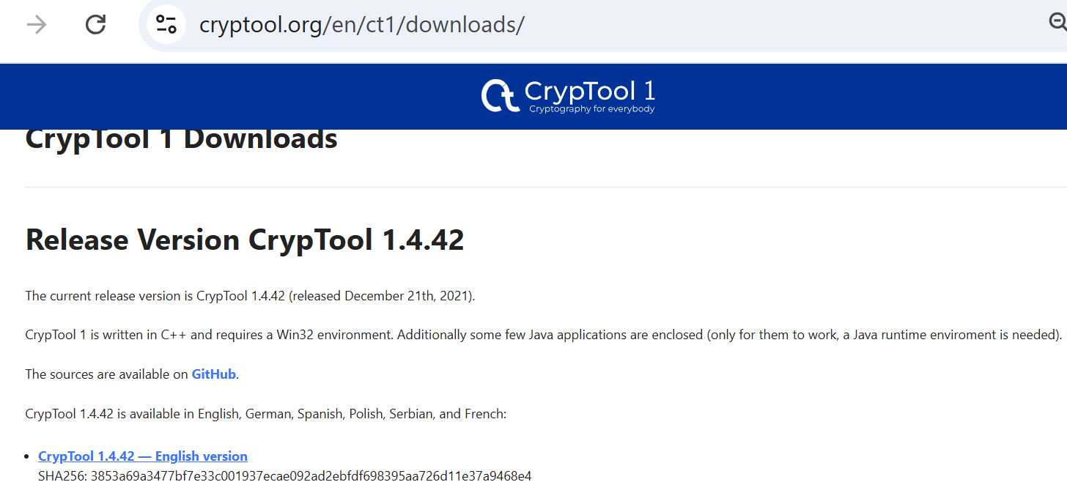
Hands-on Activity: Exploring Symmetric Encryption (Basic to Advanced)
Part 1: Classic Symmetric Encryption (Caesar Cipher in CrypTool)
Task: Download & Install CrypTool (English Version) → CrypTool Download.

Slide 16
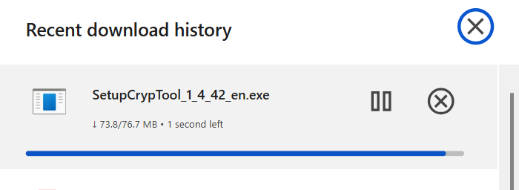
Hands-on Activity: Exploring Symmetric Encryption (Basic to Advanced)
This file will be downloading

Slide 17
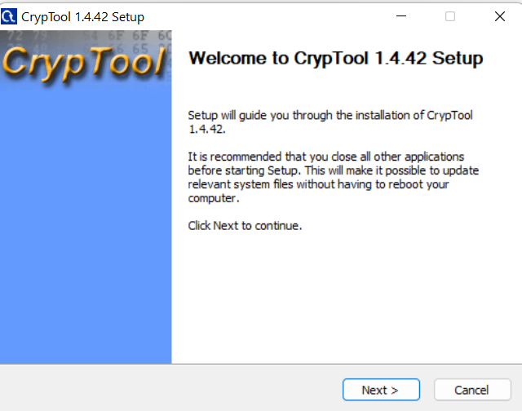
Hands-on Activity: Exploring Symmetric Encryption (Basic to Advanced)
Follow the setup steps (Next, Agree, Next, … Install)

Slide 18
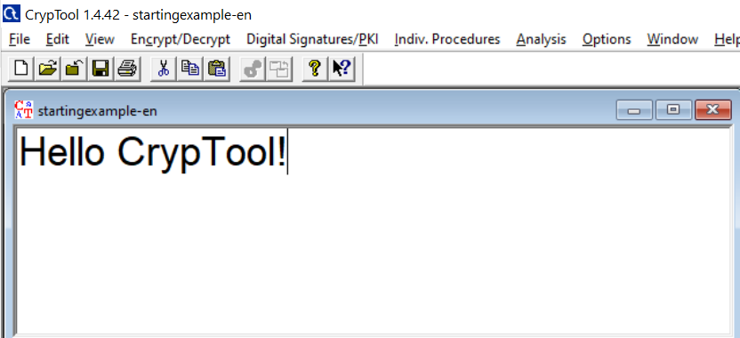
Hands-on Activity: Exploring Symmetric Encryption (Basic to Advanced)
Open CrypTool (Run As Administration) and Type a message in the main CrypTool editor window

Slide 19
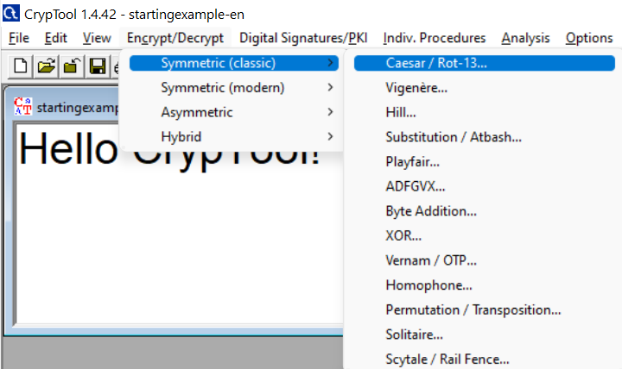
Hands-on Activity: Exploring Symmetric Encryption (Basic to Advanced)
Encrypt/Decrypt → Symmetric (classic) → Caesar/Rot-13

Slide 20
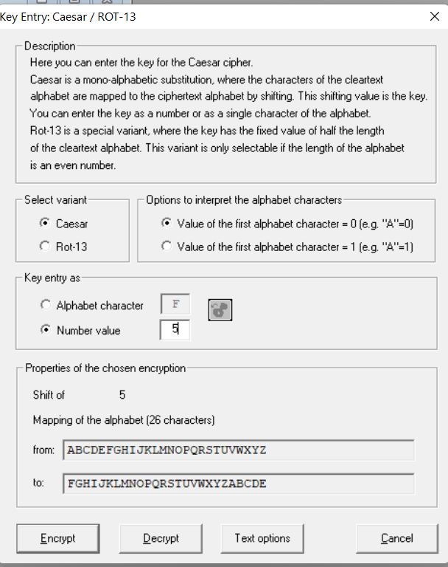
Hands-on Activity: Exploring Symmetric Encryption (Basic to Advanced)
In the Key Entry window, confirm that: Caesar is selected.
Number value is set to 5.
Click ‘Encrypt’
The encrypted text will appear in a new window

Slide 21
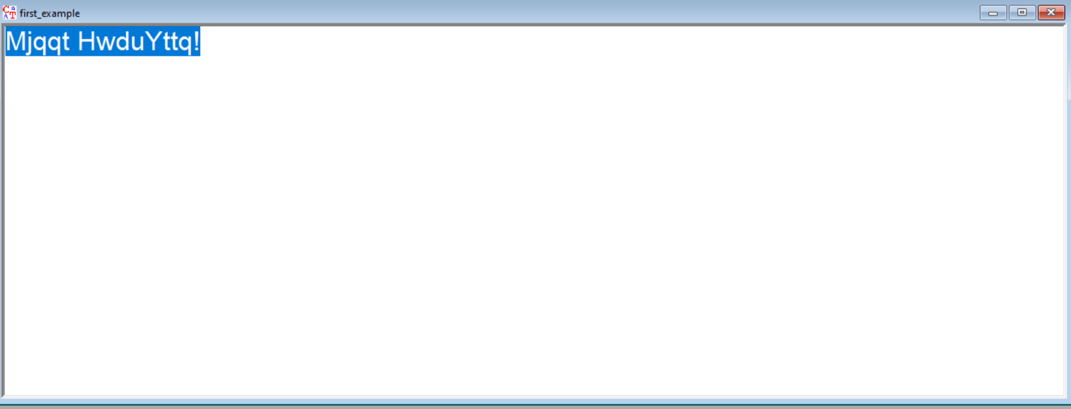
Hands-on Activity: Exploring Symmetric Encryption (Basic to Advanced)
Copy the encrypted text and save it as first_example.

Slide 22
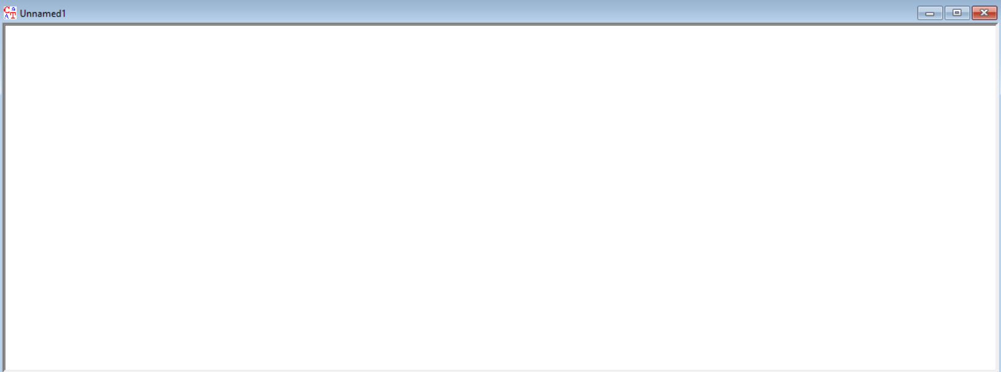
Hands-on Activity: Exploring Symmetric Encryption (Basic to Advanced)
Decrypt the Message Manually
Open a new CrypTool editor window (File → New).

Slide 23
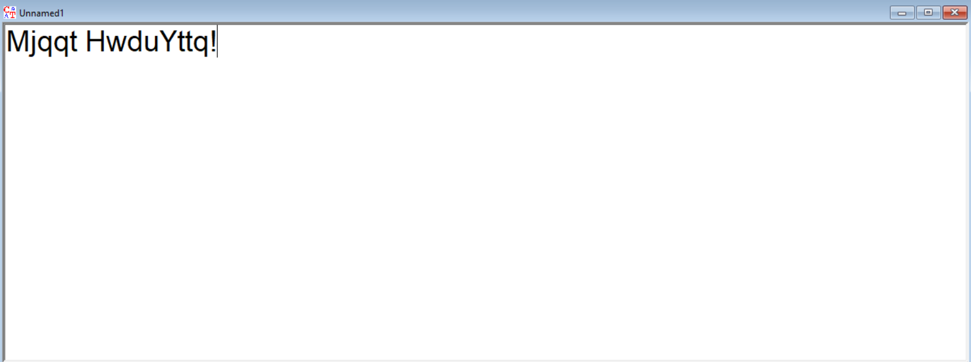
Hands-on Activity: Exploring Symmetric Encryption (Basic to Advanced)
Paste the encrypted text into the new window.

Slide 24
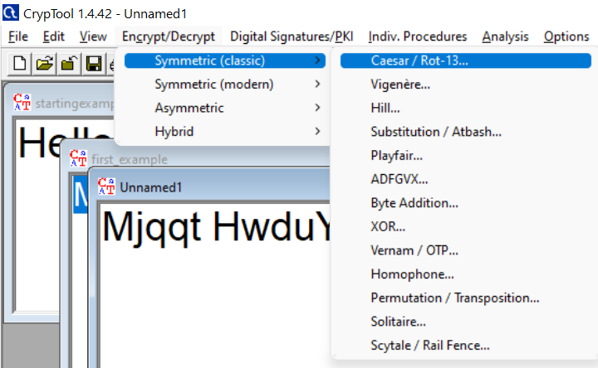
Hands-on Activity: Exploring Symmetric Encryption (Basic to Advanced)
Open Caesar Cipher window again: Encrypt/Decrypt → Symmetric (classic) → Caesar/Rot-13.

Slide 25
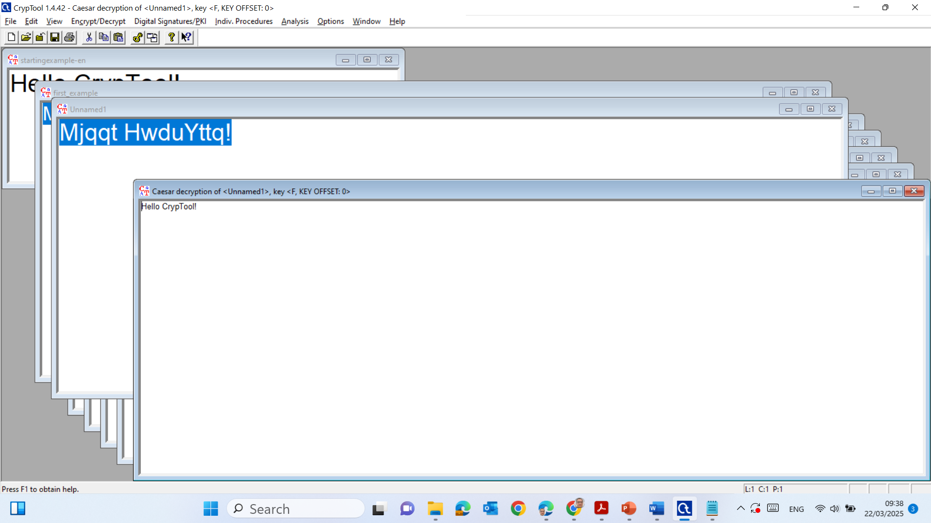
Try different shift values (starting from 1, then 2, then 3, … until 5.) until the text becomes readable.
Note the correct shift value.

Slide 26
Setting the Number value to 5 in the Caesar Cipher means that each letter in the message will be shifted forward by 5 places in the alphabet.
Example of Shift Value 5:
If message is:
HELLO
After encryption with a shift of 5, it becomes:
MJQQT

Slide 27
How It Works:
H → M (shift 5 places forward)
E → J
L → Q
L → Q
O → T
Similarly, when we decrypt, we shift the letters backward by 5 places to recover the original message.

Slide 28
Using Brute Force to Break the Cipher
We have manually decrypted the message, you can automate the decryption using CrypTool's Brute Force Analysis. This method will try all possible shift values automatically and display the correct decryption.

Slide 29
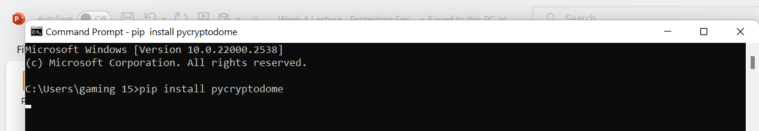
Modern Symmetric Encryption (AES in Python)
Task:
Install Required Library (if not already installed)
pip install pycryptodome

Slide 30
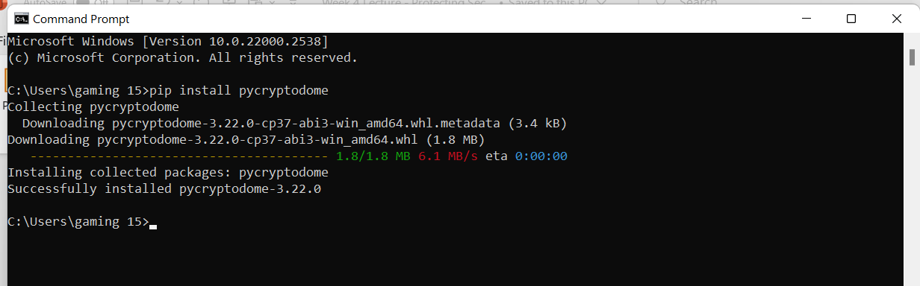
Modern Symmetric Encryption (AES in Python)

Slide 31
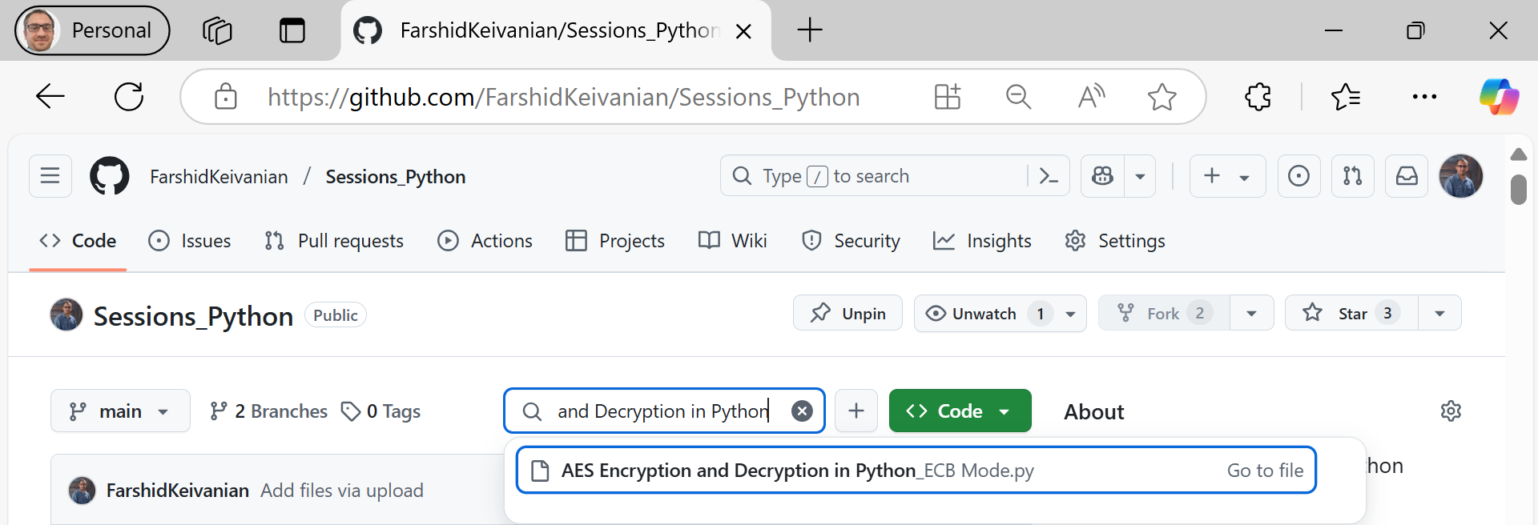
Encrypt and Decrypt a Message Using AES (Run in Python):

Slide 32
from Crypto.Cipher import AES
import base64
Import Required Libraries
Crypto.Cipher.AES: Provides AES encryption functions.
base64: Used for encoding and decoding encrypted data in a readable format.

Slide 33
def pad(text):
return text + (16 - len(text) % 16) * ' '
Padding Function (Ensures Message Length is a Multiple of 16)
AES requires input text to be a multiple of 16 bytes.
This function adds extra spaces to make sure the length meets this requirement.

Slide 34
key = "thisisasecretkey" # Must be 16, 24, or 32 bytes
message = "Hello from Australia!"
Define Key and Message
The AES key must be 16, 24, or 32 bytes long (here, it's 16 bytes).
The message is the text we want to encrypt.

Slide 35
cipher = AES.new(key.encode('utf-8'), AES.MODE_ECB)
Create an AES Cipher Object (ECB Mode)
Creates an AES encryption object in ECB (Electronic Codebook) mode.
ECB mode encrypts each block independently, making it less secure than CBC.

Slide 36
encrypted_text = base64.b64encode(cipher.encrypt(pad(message).encode('utf-8')))
Encrypt the Message
Pads the message to a multiple of 16 bytes.
Encrypts the padded message using AES.
Base64 encodes the output so it's printable.

Slide 37
print(f"Encrypted: {encrypted_text.decode()}")
decrypted_text = cipher.decrypt(base64.b64decode(encrypted_text)).decode().strip()
Print Encrypted Message
Displays the encrypted message in Base64 format.
Decrypt the Message
Base64 decodes the encrypted text.
Decrypts it using the same AES key.
Removes padding with .strip() to get the original message.

Slide 38
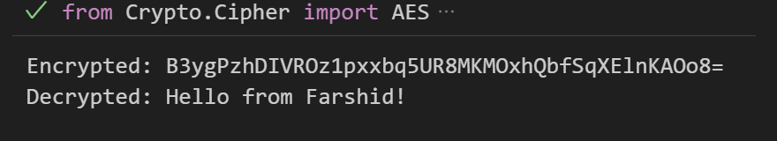
print(f"Decrypted: {decrypted_text}")
Print Encrypted Message
Displays the original message after decryption.

Slide 39
Key Takeaways:
Uses AES encryption (ECB mode) for securing a message.
Base64 encoding ensures the encrypted text is readable.
Padding makes the message compatible with AES block size.
Decryption restores the original message.

Slide 40
Discussion:
How does AES encryption differ from Caesar cipher?
Feature | Caesar Cipher | AES Encryption
Type of Encryption | Classical (simple substitution) | Modern (block cipher)
Key Strength | Single number (shift value, e.g., 5 or 10) | 128-bit, 192-bit, or 256-bit key

Slide 41
Feature | Caesar Cipher | AES Encryption
Encryption Method | Shifts letters forward/backward | Complex mathematical transformations (Substitution-Permutation)
Security Level | Very weak (easily brute-forced) | Extremely strong (practically unbreakable)

Slide 42
Feature | Caesar Cipher | AES Encryption
Usage Today | No longer used for security | Used in banking, government, and Wi-Fi security

Slide 43
Key takeaway: Caesar cipher is a simple shift-based encryption, while AES uses advanced mathematical operations that make decryption nearly impossible without the key.

Slide 44
Discussion:
Why is AES secure compared to classical encryption?
Large Key Size – AES uses 128-bit, 192-bit, or 256-bit keys, making brute-force attacks impractical.
Complex Encryption Process – It includes multiple rounds of Substitution, Permutation, Mixing, and Key Expansion, unlike simple letter shifts in Caesar cipher.

Slide 45
Resistance to Cryptanalysis – AES is designed to resist attacks like frequency analysis, which easily breaks classical ciphers like Caesar cipher.
Used in Real-world Security – AES is used in banking, online transactions, VPNs, and government systems, whereas Caesar cipher is only for educational purposes.

Slide 46
Key takeaway: AES is secure because of its large key size, complex transformations, and resistance to brute force and cryptanalysis.

Slide 47
Conclusion:
Basic Encryption (Caesar Cipher) is vulnerable to brute force.
Modern Encryption (AES) is secure but requires proper key management.
Real-World Use: Banks, government systems, and Wi-Fi security use AES.

Slide 48
Popular Symmetric Algorithms
Algorithm | Description | Where It's Used (AU Examples)
AES | Modern, strong, fast encryption | MyGov, Australian Tax Office secure logins
3DES | Improved version of older DES | Legacy government systems
Blowfish | Strong, flexible block cipher | File encryption tools in Aussie security firms
7 |

Slide 49
Popular Symmetric Algorithms
Algorithm | Description | Where It's Used (AU Examples)
RC4/5/6 | Stream/block cipher variants | Legacy systems, older Wi-Fi (WEP)
SkipJack | Developed by NSA, rarely used today | Academic research
IDEA | High security, less common now | Used in older encrypted emails
7 |

Slide 50
Research Discussion Questions
Research Discussion Questions
Q1: Why do organisations still use symmetric encryption even though public-key encryption exists?
A1: It’s much faster and more efficient for large data transfers.
7 |

Slide 51
Symmetric-key Algorithms
Widely known symmetric-key algorithms
DES/ 3DES
SkipJack
Blowfish/ Twofish
RC4/ RC5/ RC6
AES
IDEA

Slide 52
Stream Cipher
A stream cipher encrypts data one bit or byte at a time using a pseudo-random key stream, making it fast and simple for real-time communication.
They're great for secure Wi-Fi (like WPA2), mobile calls, or live video streaming in Australia where speed matters more than bulk encryption.

Slide 53
Block vs Stream Cipher – Quick Comparison
Feature | Stream Cipher | Block Cipher (e.g., AES)
Data Handling | Bit/byte at a time | Fixed-size blocks (e.g., 128 bits)
Speed | Faster for real-time data | Slower, but stronger for large files
Use Case in Australia | Wi-Fi (WPA2), mobile comms | SecureGov, ATO file encryption

Slide 54
Linear Feedback Shift Registers
An LFSR is a simple circuit that shifts bits and uses a linear function (like XOR) to create new ones — it's like a clever pattern generator.
Used in stream ciphers, random number generators, and secure wireless comms (like in mobile apps or IoT devices across Australia).

Slide 55
Linear Feedback Shift Registers
LFSR Example (4-bit, XOR Feedback)
Let’s assume:
Initial register state: [1, 0, 0, 1] (this is the seed)
Feedback taps: first and fourth bits (XOR of bit 1 and bit 4)
Shift direction: left to right

Slide 56
Step | Register (Before Shift) | Feedback (1st ⊕ 4th) | New Bit (Inserted at Left) | Output = Rightmost Bit
0 | 1 0 0 1 | 1 ⊕ 1 = 0 | 0 | 1 (rightmost)
1 | 0 1 0 0 | 0 ⊕ 0 = 0 | 0 | 0
2 | 0 0 1 0 | 0 ⊕ 0 = 0 | 0 | 0
3 | 0 0 0 1 | 0 ⊕ 1 = 1 | 1 | 1
4 | 1 0 0 0 | 1 ⊕ 0 = 1 | 1 | 0
... | ... | ... | ... | ...

Slide 57
The feedback bit (new bit) is computed using XOR of specific taps.
The register shifts right, and the new bit is inserted on the left.
Each step produces one output bit, forming a pseudo-random sequence.

Slide 58
Where is this used in Australia?
LFSRs are used in digital TV encryption, mobile phone scrambling, and Bluetooth pairing, including devices used across Australia.

Slide 59
RC4 Encryption Algorithm

Slide 60
Software-Oriented Stream Ciphers
LFSRs are slow in software
Alternatives:
Block ciphers (or hash functions) in CFB, OFB, CTR modes
Stream ciphers designed for software:
RC4
SEAL (Software-Optimized Encryption Algorithm)

Slide 61
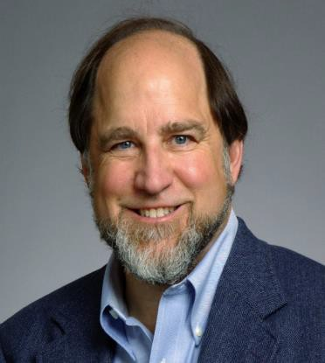
RC4
What is RC4?
A fast, stream cipher that generates a pseudo-random keystream.
Uses a 256-byte state table (S-box) and a key scheduling algorithm (KSA).
Encrypts by XORing the keystream with plaintext.
Professor Ron Rivest
Electrical Engineering & Computer Science Massachusetts Institute of Technology (MIT)

Slide 62
RC4
RC4 is simple and fast, but modern cryptography no longer recommends it due to known vulnerabilities.

Slide 63
RC4 Components
RC4 uses two arrays
A 256-byte state table (also called S-Box)
S[ ] = [ S[0], …, S[255] ]
A key of variable size, consisting of up to 2048 bits (i.e., 256 bytes)
K[ ] = [ K[0], K[1], … ]

Slide 64
RC4 Algorithm
It has 2 counters: i & j and initialised to zero
i = (i + 1) mod 256
j = (j + S_{i} ) mod 256 Swap S_{i} and S_{j}
t = (S_{i} + S_{j} ) mod 256
K = S_{t}
Byte K is XORed with the plaintext to produce ciphertext or XORed with the cipertext to produce plaintext

Slide 65
RC4 Algorithm (Cont.)
S-Box Creation
input key;
if (key < 256 bytes) {
repeat key until 256 bytes;
}
for (i=0; i < 256; ++i) {
S[i] = i; // initialize S-Box K[i] = K[i mod keylen];
}
j = 0;
for (g = 0; g <256; ++g) {
j = (j + S[g] + K[g]) mod 256;
swap(S[g],S[j]);
}
Keystream Generator
i = 0; j = 0;
loop {
i = (i+1) mod 256;
j = (j+S[i]) mod 256;
Swap(S[i],S[j]);
t = (S[i] + S[j]) mod 256; ks_byte = S[t];
}
Output S-Box entry (byte) as a byte of the keystream
S-Box: key dependent permutation of 0 to 255. Update S-Box entry

Slide 66
Asymmetric Encryption

Slide 67
Public-Key Encryption (Asymmetric Encryption)
Key Idea:
Uses two keys: Public Key (for encryption) and Private Key (for decryption).
Messages encrypted with a public key can only be decrypted with the corresponding private key.
Ensures secure communication without needing a shared secret key.

Slide 68
Public-Key Encryption (Asymmetric Encryption)
How It Works:
Sender encrypts a message using the receiver's public key.
Only the receiver can decrypt it using their private key.
Even if someone intercepts the encrypted message, they cannot decrypt it without the private key.

Slide 69
Public-Key Encryption (Asymmetric Encryption)
Real-world Examples in Australia:
Online Banking (Commonwealth Bank, ANZ, NAB, Westpac) uses RSA for secure transactions.
MyGov uses digital signatures for identity verification.
Australian Taxation Office (ATO) uses asymmetric encryption for secure e-filing.

Slide 70
Public-Key Encryption (Asymmetric Encryption)
Comparison Table: Symmetric vs. Asymmetric Encryption
Feature | Symmetric Encryption | Asymmetric Encryption
Keys Used | Single shared key | Public & Private keys
Speed | Faster | Slower (computationally expensive)

Slide 71
Public-Key Encryption (Asymmetric Encryption)
Comparison Table: Symmetric vs. Asymmetric Encryption
Feature | Symmetric Encryption | Asymmetric Encryption
Security | Risky if key is leaked | More secure (private key stays secret)
Example | AES, DES, RC4 | RSA, ECC, Diffie-Hellman

Slide 72
Public-Key Encryption (Asymmetric Encryption)
Comparison Table: Symmetric vs. Asymmetric Encryption
Feature | Symmetric Encryption | Asymmetric Encryption
Use Cases | File encryption, VPNs | Online banking, Digital signatures

Slide 73
Public-Key Encryption (Asymmetric Encryption)
Research Discussion Questions
Why is asymmetric encryption slower than symmetric encryption? Can we optimize it?
It requires complex mathematical computations (e.g., RSA uses large prime factorization). Optimizations like Elliptic Curve Cryptography (ECC) help improve efficiency.

Slide 74
Public-Key Encryption (Asymmetric Encryption)
How does public-key encryption enhance security in online banking?
Online banks use RSA to encrypt login credentials and transactions, ensuring only the user’s device (with the private key) can decrypt the information.

Slide 75
Numerical Value Problem: RSA Key Generation
Problem Statement:
Choose two prime numbers p = 3 and q = 5.
Compute n = p × q.
Compute Euler's Totient Function (ϕ) as ϕ(n) = (p-1) × (q-1).
Choose a public exponent e = 3 (which is coprime to ϕ(n)).
Find the private key d, which satisfies (e × d) mod ϕ(n) = 1.

Slide 76
Solution Steps:
1. Compute n:
n = p × q = 3 × 5 = 15
2. Compute ϕ(n):
ϕ(15) = (3−1) × (5−1) = 2 × 4 = 8
3. Choose a public exponent eee: Let e=3, which is coprime to ϕ(n) = 8
3. Find the private key d, such that
(e × d) mod ϕ(15) = 1 (3 × d) mod 8 = 1

Slide 77
Try small values of d until the equation holds:
3×1 = 3 mod 8 = 3
3×2 = 6 mod 8 = 6
3×3 = 9 mod 8 = 1
So, d = 3 is the modular inverse of e = 3 mod ϕ(n) = 8

Slide 78
Final RSA Key Pair:
Public Key: (e=3, n=15)
Private Key: (d=3)
Final Takeaway
Public-key encryption enables secure communication without sharing secret keys. While RSA is widely used, modern alternatives like ECC offer better security with shorter key lengths.

Slide 79

Example Using CrypTool with DES (CBC) Mode
DES Encryption (CBC mode)
Step 1: Open CrypTool → Go to File → New

Slide 80
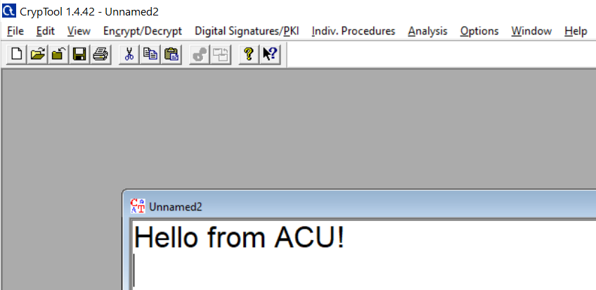
Example Using CrypTool with DES (CBC) Mode
→ Type a simple message like:

Slide 81
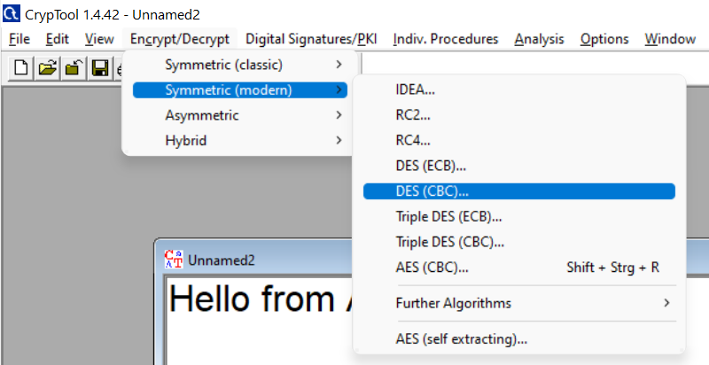
Example Using CrypTool with DES (CBC) Mode
Step 2: Encrypt/Decrypt → Symmetric (modern) → DES (CBC)..

Slide 82
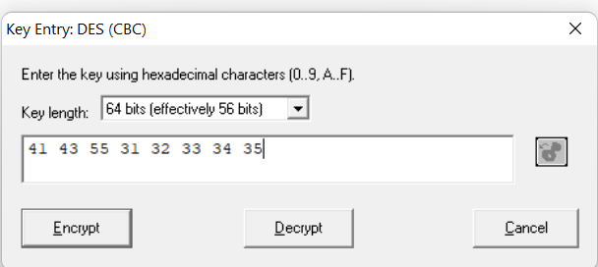
Example Using CrypTool with DES (CBC) Mode
Step 3: You’ll see a “Key Entry” window asking for hexadecimal values.
Here's what to enter:

Slide 83
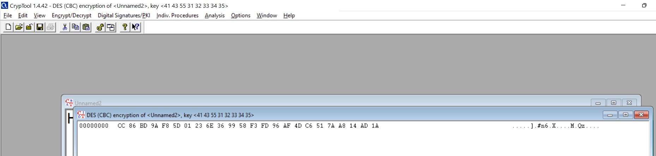
Example Using CrypTool with DES (CBC) Mode
You will see unreadable ciphertext in a new window

Slide 84
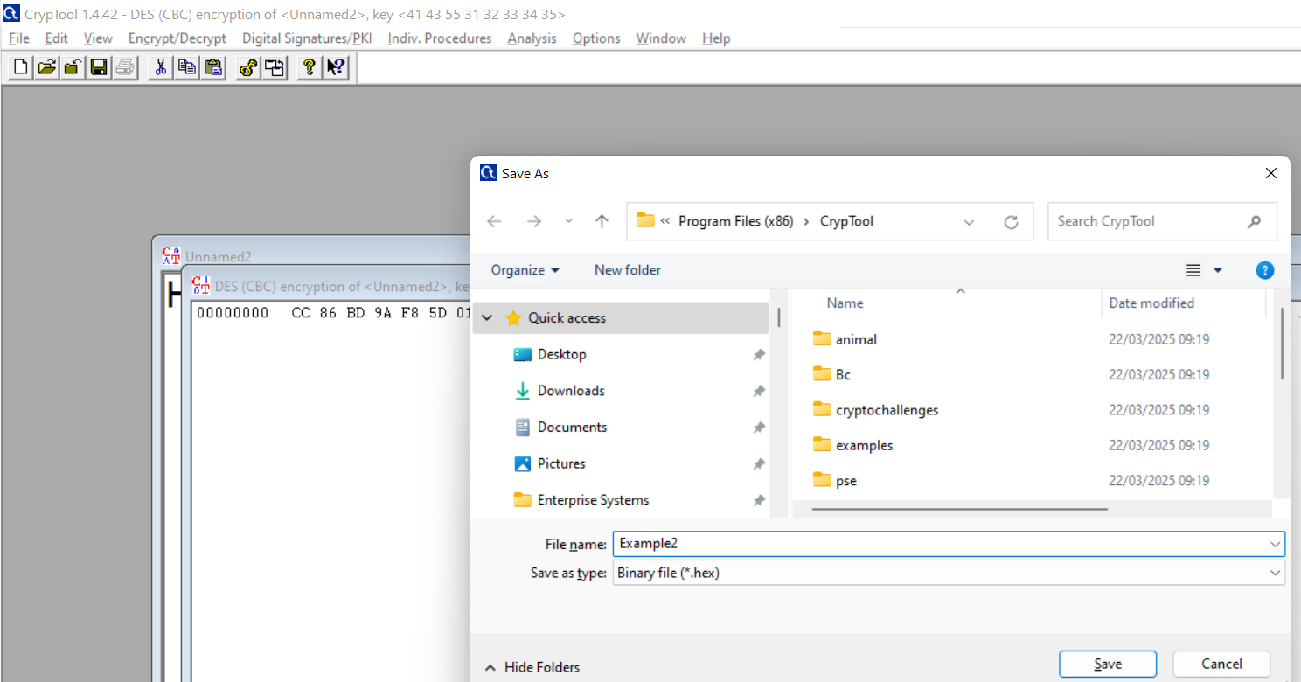
Example Using CrypTool with DES (CBC) Mode
Step 4: Copy that ciphertext → Go to File → New → Save it As a new file

Slide 85
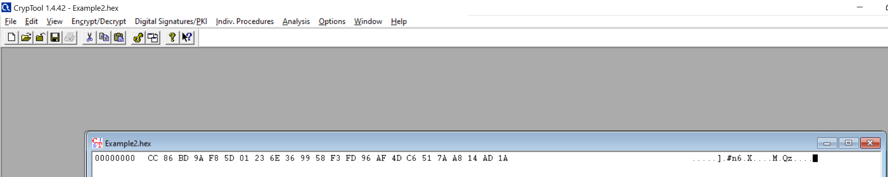
Example Using CrypTool with DES (CBC) Mode
It is the encrypted message in hexadecimal format
Now for Decryption
Click inside the ciphertext window (Example2.hex) to activate it.
From the top menu, go to: Encrypt/Decrypt → Symmetric (modern) → DES (CBC)...

Slide 86
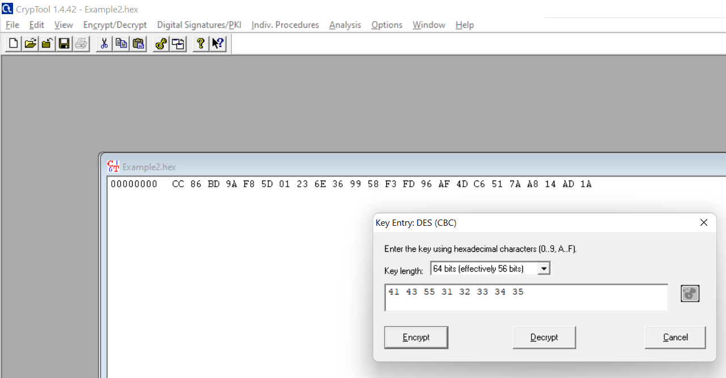
Example Using CrypTool with DES (CBC) Mode
Enter the Same Key and IV
A pop-up will appear asking for a key and IV. Now:
In the Key field, enter this hexadecimal value:

Slide 87
Example Using CrypTool with DES (CBC) Mode
Click on Decrypt

Slide 88
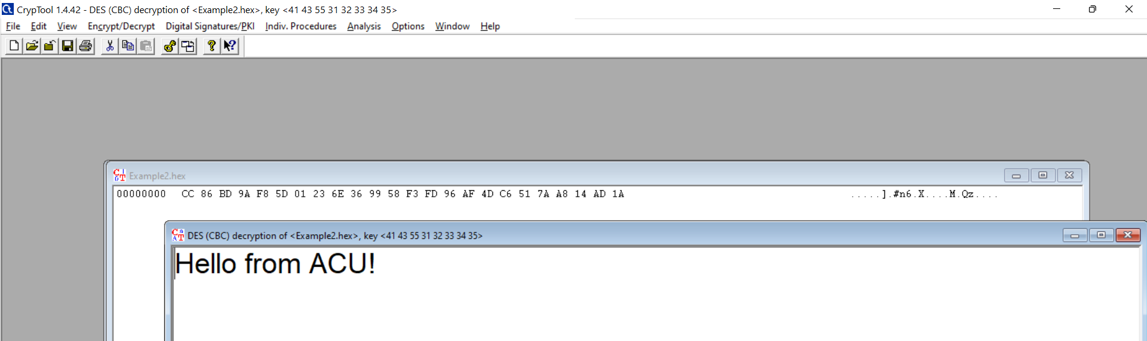
Example Using CrypTool with DES (CBC) Mode
A new window will pop up showing the original message:

Slide 89
RSA Encryption Algorithm

Slide 90



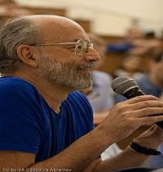

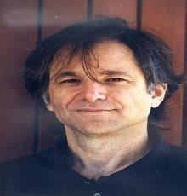
RSA Algorithm
RSA was proposed by Rivest, Shamir & Adleman, in
1977
It is the best known & widely used public-key
Ronald Rivest
cryptography
Uses large integers (e.g. 1024 bits)
Security due to cost of factorizing large integers
Adi Shamir
Leonard Adleman

Slide 91
RSA – Key Generation
The ingredients are the following:
p, q, two prime numbers (private, chosen)
n = pq
φ(n) = (p-1)(q-1)
e with gcd(φ(n),e)=1
ed = 1 mod φ(n)
(public, calculated)
(private, calculated) (public, chosen)
(private, calculated)
Public key KU = {e,n} Private key KR = {d, n}

Slide 92
RSA Encryption / Decryption
RSA Algorithm
For plaintext M, the encryption / decryption are as follows:
Encryption: C = Me mod n
Decryption: M = C^{d} mod n

Slide 93
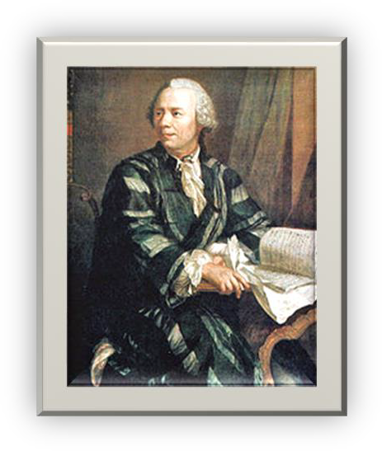
RSA Mathematics Basis
A theorem in Number Theory by Euler
Theorem: For any two prime numbers p and q, and integers n=pq and m with 0<m<n
_{m}l⋅ϕ (n)+1
= m mod n
for any integer l.
Leonhard Euler (1707 – 1783)
Swiss mathematician & physicist
Example:
p = 17,
q = 11,
n = 187, ø(n) = 160
₃321
mod 187 =
₃(2.160+ 1)
mod 187 = 3

Slide 94
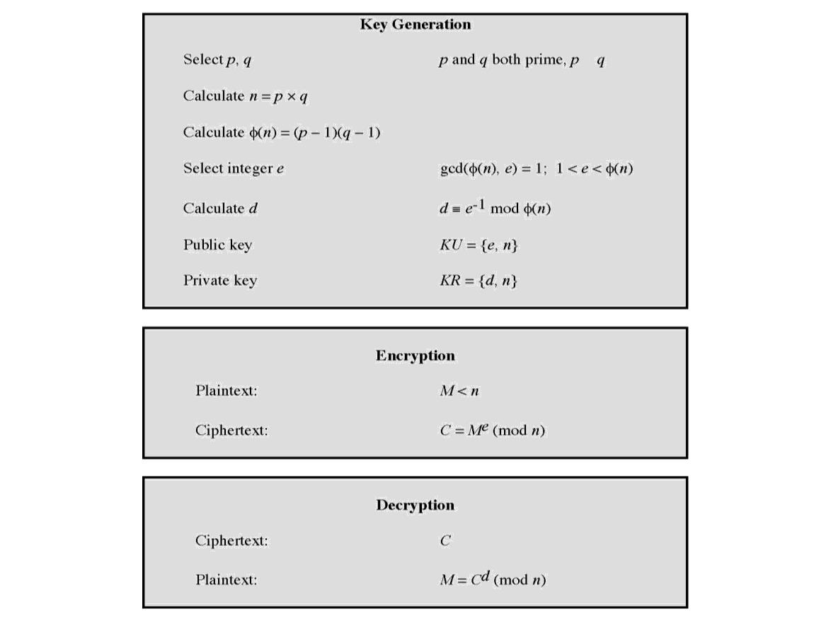
RSA Algorithm

Slide 95
RSA Example
Select primes: p=17 & q=11
Compute n = pq =17×11=187
Compute ø(n)=(p–1)(q-1)=16×10=160
Select e: gcd(e,160)=1; choose e=7
Determine d: de=1 mod 160 and since 23×7=161= 1×160+1
Publish public key KU={7,187}
Keep secret private key KR={23,187}
Value is d=23

Slide 96
RSA Example (Cont…)
RSA encryption/decryption will be Given message M = 88 Encryption:
C = 88⁷
Decryption:
M = 11²³
mod 187 = 11
mod 187 = 88

Slide 97
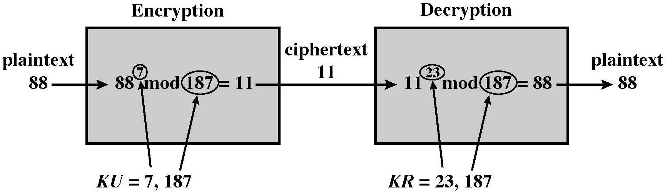
RSA Example (Cont…)

Slide 98
RSA Security
Some approaches to attacking RSA
Brute force key search – it is infeasible given size of numbers
Mathematical attacks, factorizing the integer n – is it difficult ?

Slide 99
Mathematical Attacks on RSA
Mathematical attacks are based on the following idea:
Computing the private key from the public key
Public key: KU={e, n} / private key: KR={d, n}
Need to get d from e
e and d satisfy: ed = 1 mod φ(n), where
n=pq and φ(n)=(p-1)(q-1)
So it requires to compute p and q, from n.
The problem of calculating p and q from n (that is, factorizing n) is a HARD
problem

Slide 100
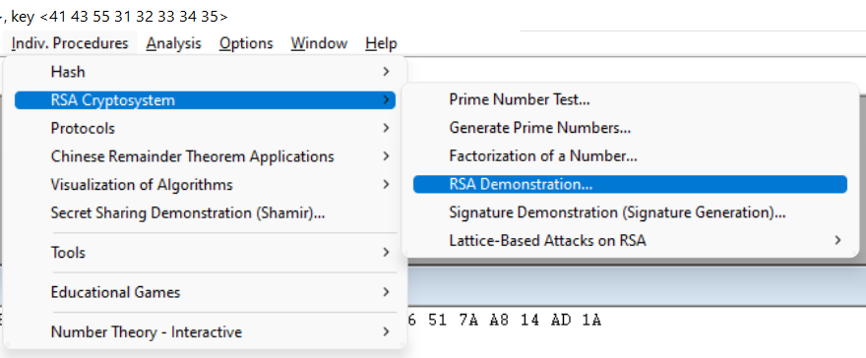
CrypTool Activity: RSA Simulation
Open CrypTool → Indiv. Procedures → RSA Demonstration

Slide 101
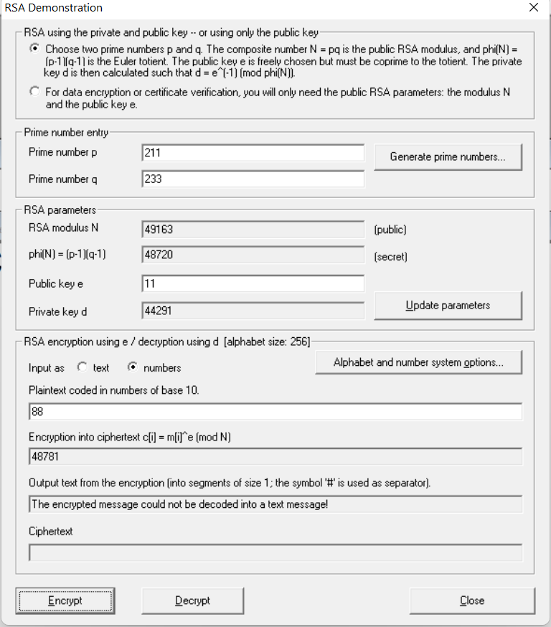
CrypTool Activity: RSA Simulation
Set Parameters
Click Encrypt → See ciphertext
The RSA encryption successfully transformed the plaintext 88 into ciphertext 48781, confirming correct key setup and encryption process.

Slide 102

CrypTool Activity: RSA Simulation
3. Decrypt
The RSA decryption failed because the decrypted number 17787 does not match the original plaintext 88, likely due to incorrect ciphertext input or mismatch in key values

Slide 103
CrypTool Activity: RSA Simulation
Summary of What You Achieved:
Step | Value
Primes | p = 211, q = 233
n (modulus) | 49163
φ(n) | 48720
e (public) | 11
d (private) | 44291
Message | M = 88
Ciphertext | C = 48781
Decrypted M | 88

Slide 104
Break the RSA Cipher

Slide 105
Hack a Message
Suppose, Alice has a public key (N, e) = (55, 3).
Alice is in a conversation with Bob and asks Bob to guess her age.
Bob makes a guess about Alice’s age and encrypts the number before sending to Alice. Suppose Bob assumes that Alice is 18 years old.
Now, Bob sets M = 18. Then, he computes C ≡ Me ≡ 18³ (mod 55) = 2.
Bob sends the ciphertext to Alice.

Slide 106
Hack a Message (cont.)
Eve receives the message and wants to decrypt it.
Only knowing public key of Alice, can she decrypt the message?
YES, She can !!!!!!

Slide 107
Hack a Message (cont.)
Eve knows public key of Alice (N, e) = (55, 3).
She could easily get p and q by factorizing N, i.e. 5 x 11 = 55.
Thus, she can derive φ(n), i.e., 40.
Now, she calculates de=1 mod 40; 3d=1 mod 40; d = 27.
She simply computes, M = C^{d} mod N = 2²⁷ mod 55 = 18.

Slide 108
Hack a Message (cont.)
What method Eve used to decrypt the message?
What is the name of the attack?
Why the attack was successful?
What should we do to make the RSA encryption secure?
How many digits should we use for the prime numbers?

Slide 109
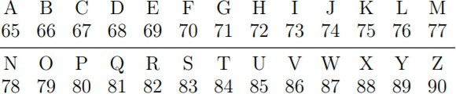
Exercise
ASCII is a standard way to represent characters as numbers. For example, a space is represented by 32, a comma is 44, and a period is 46. The capital letters are also 2 digit integers as shown above.
Suppose, my RSA public key is (N, e) = (629, 17)
Encrypt the letter A by converting to ASCII, then encrypting using my public key. (You should get 337.)
I have encrypted a short message. Can you break RSA to read the message?
Each cipher-text represents 1 letter.
My message is: 247, 337, 322, 463, 15, 73, 440, 15, 342, 323, 435

Slide 110
Answer?
Private key? Secret Message?

Slide 111
Summary
Have considered:
Symmetric Encryption
Asymmetric Encryption
LFSR
RC4
RSA

Slide 112
Appendix
629 = 17 (p) x 37 (q)
= 16 (p-1) x 36 (q-1)
= 576 ø(n)
de mod 576 = 1
17d mod 576 = 1
576 = 33(17) + 15
17 = 1 (15) + 2 => 2 = 17 – 1(15)
15 = 7 (2) + 1
1 = | 15 – 7(2)
= | 15 – 7 (17 – 1(15))
= | 1(15) - 7(17) + 7(15)
= | 8 (15) – 7 (17)
= | 8 (576 – 33(17)) – 7(17)
= | 8(576) -264(17) – 7(17)
= | 8(576) – 271(17)
= | 305

Slide 113

Questions?

